Slide 1





Data at Work: Building Insights from Survey, and Census data
Dr. Christy Byrd
Associate Professor
Program Coordinator, Educational Equity
College of Education
Dr. Jeanne McClure
Postdoctoral Scholar
Data Science and AI Academy

Slide 2







ABOUT - The DSA Offers
COURSES (DSC)
INTERNSHIPS
SEED GRANTS
MINOR and CERTIFICATES
PROGRAMS
COLLABORATIVE CONSULTING
K-12 OUTREACH

Slide 3



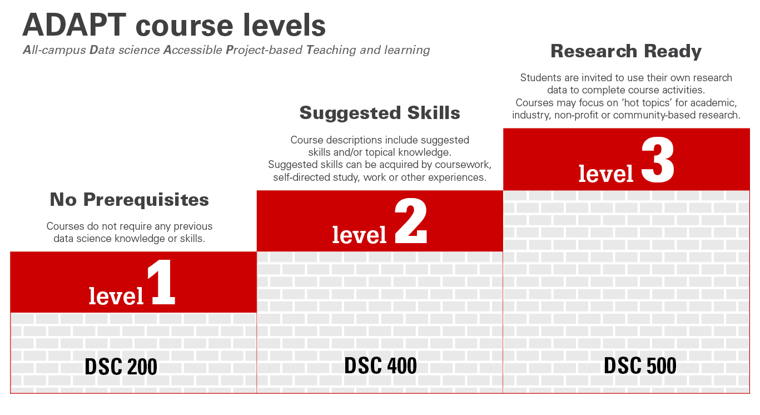
COURSES
The DSA offers 1-credit hour, project-based courses at three levels ensuring we reach all interested learners.
The Data Science Academy designs and delivers instruction through the ADAPT model: All-campus Data science through Accessible Project-based Teaching and learning.

Slide 4
Welcome and agenda
DAY 1 - Sept. 30 (2pm - 4pm)
Types of Surveys
Common LA Workflow
Intro to Survey Analysis in R with dataset
DAY 2 - Oct. 7 (2pm - 4pm)
US Census
weights
{tidycensus} workbook
Do your own analysis!

Slide 5

Fundamentals of Survey Design
Types of Surveys
Census or Universal
Sample Survey
Sampling Methods
Probability
Simple Random Sample
Complex Surveys
Stratification
Clustering
Multi-stage
Non Probability

Slide 6
Fundamentals of Survey Design
Definition:
Collect data from every member of the target population
Types of Surveys
Census or Universal
Sample Survey
Characteristics:
Comprehensive and detailed information.
Eliminates sampling error
Challenges:
Time-consuming and costly
Logistically complex
Potential non-response issues
Advantages:
Complete population coverage
Enables in-depth subgroup analysis

Slide 7
Fundamentals of Survey Design
Definition:
Collect data from a subset (sample) of the target population
Types of Surveys
Census or Universal
Sample Survey
Characteristics:
Less comprehensive but more efficient than a census
Involves estimation and sampling error
Challenges:
Potential sampling bias
Requires careful design to ensure representativeness
Advantages:
Cost-effective and time-saving
Easier to manage and implement

Slide 8
Fundamentals of Survey Design
Definition:
Every individual has an equal chance of being selected
Sampling Methods
Probability
Simple Random Sample
Complex Surveys
Stratification
Clustering
Multi-stage
Non Probability
Selection is completely random
Simplest form of probability sampling
Characteristics:
Requires a comprehensive list of the population
May not be efficient for large populations
Challenges:
Easy to implement with a complete sampling frame
Unbiased representation of the population
Advantages:

Slide 9
Fundamentals of Survey Design
Definition:
Divides population into subgroups (strata) and samples from each
Sampling Methods
Probability
Simple Random Sample
Complex Surveys
Stratification
Clustering
Multi-stage
Non Probability
Strata are based on shared characteristics
Can be proportionate or disproportionate
Characteristics:
Challenges:
Requires detailed population information
More complex to design and analyze
Advantages:
Ensures representation of all subgroups
Increases precision of estimates

Slide 10
Fundamentals of Survey Design
Population divided into clusters; entire clusters are sampled.
Definition:
Sampling Methods
Probability
Simple Random Sample
Complex Surveys
Stratification
Clustering
Multi-stage
Non Probability
Clusters often based on geography
or organization.
Two types: single-stage and two-stage cluster sampling.
Characteristics:
Higher sampling error compared to simple random sampling.
Clusters may not be homogeneous.
Challenges:
Cost-effective for geographically dispersed populations.
Reduces travel and administrative costs.
Advantages:

Slide 11
Fundamentals of Survey Design
Combines multiple sampling methods in stages.
Definition:
Sampling Methods
Probability
Simple Random Sample
Complex Surveys
Stratification
Clustering
Multi-stage
Non Probability
Involves selecting clusters, then sampling within them
Flexible and adaptable to complex populations
Characteristics:
Challenges:
Complex design and analysis
Increased potential for sampling error
Efficient for large-scale surveys
Reduces costs while maintaining representativeness
Advantages:

Slide 12
Fundamentals of Survey Design
Sampling methods where not every member has a known chance of being selected
Sampling Methods
Probability
Simple Random Sample
Complex Surveys
Stratification
Clustering
Multi-stage
Non Probability
Definition:
Convenience Sampling
Quota Sampling
Purposive (Judgmental) Sampling
Snowball Sampling
Types:
Challenges:
High risk of sampling bias
Limits ability to generalize findings
Easier and quicker to conduct
Useful for exploratory research
Advantages:

Slide 13
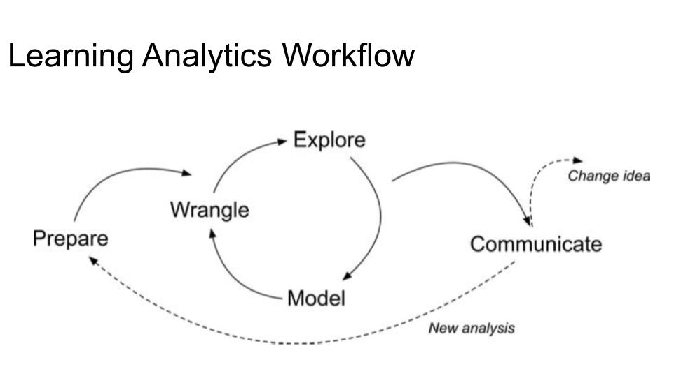
(Krumm et al., 2018)

Slide 14
References
Kalton, G. (2020). Introduction to survey sampling (No. 35). Sage Publications.
Krumm, A., Means, B., & Bienkowski, M. (2018). Learning analytics goes to school: A collaborative approach to improving education. Routledge.
Lohr, S. L. (2021). Sampling: design and analysis. Chapman and Hall/CRC.
Rossi, P. H., Wright, J. D., & Anderson, A. B. (Eds.). (2013). Handbook of survey research. Academic press.

